Slide 1


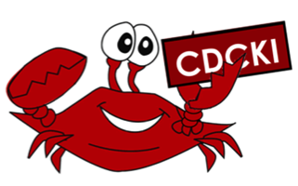
CKI Brand Guide
Capital District Circle K International
Membership Development & Education Committee
July 2014

Slide 2
What is the Brand Guide?
Circle K International released a new brand guide which you can check out here!
You can also click here for links to downloadable images.
The brand guide provides sets of logos, fonts, colors, backgrounds, and graphic elements to help spice up club resources.

Slide 3




Textured Backgrounds
Chalkboard
White Grunge
Cardboard
Dark Grunge

Slide 4


Stripes
A variety of colors are available to download on the CKI website: blue, light blue, light gray, green, maroon, orange, turquoise, yellow

Slide 5

CKI Colors

Slide 6


Carets and Quotes
Carets are available in a variety of colors as well: blue, cyan, green, light blue, light green, maroon, orange, yellow
Quotes: blue, cyan. gray, green, light blue, light green, maroon, orange, yellow

Slide 7
Fonts
Myriad Pro
Century Gothic
Verdana
Garamond Premier Pro
Goudy Oldstyle
Archer
American Typewriter

Slide 8



Logos
There are also a number of premade logos available:
  CKI (wordmark and seal)
  Eliminate
  Kiwanis SLP

Slide 9
Why use the new brand guide?
With CKI's new brand guide, you have the opportunity to share what makes CKI awesome. Spread the word by using some of these ready-made design elements to create eye-catching materials—newsletters, T-shirts, websites and more!
The CKI brand guide was designed to help you build your club's brand while you're putting your creativity in action. Inside the brand guide, you'll find information about the official CKI logos, fonts, colors, graphics and more.

Slide 10
So try out the new brand guide and have some fun! Be creative in spreading the word about CKI!

